Slide 1
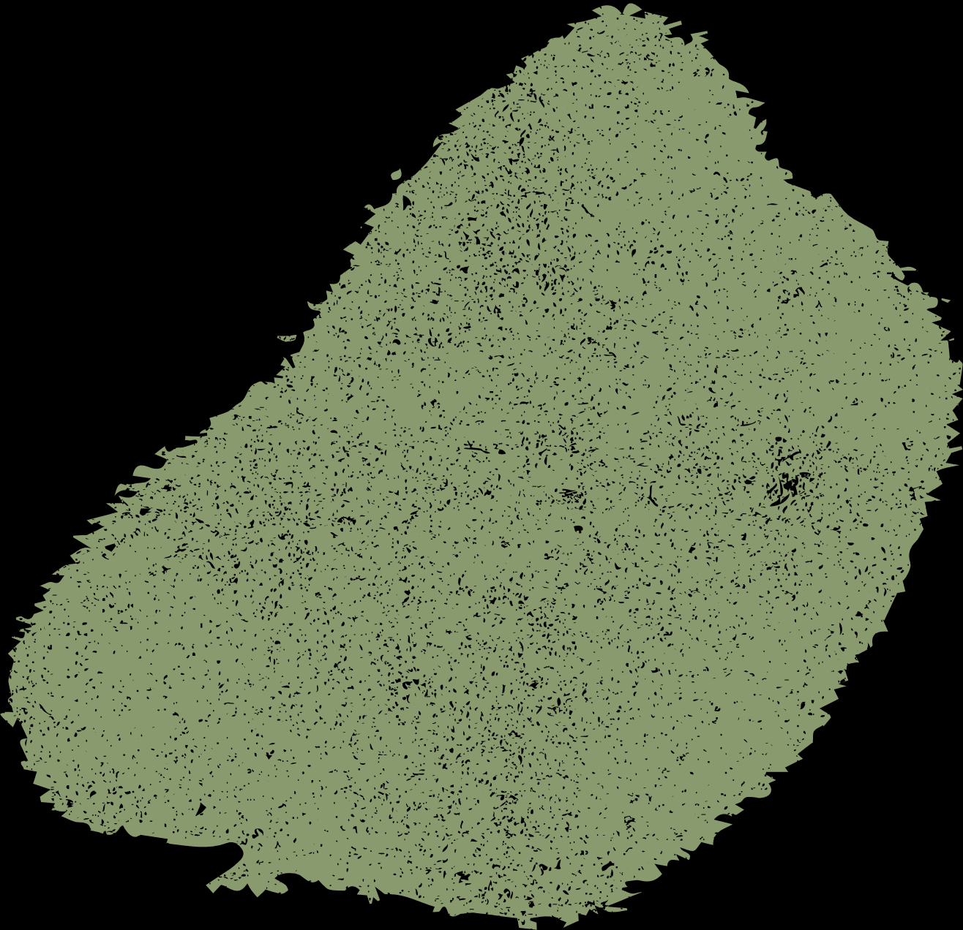





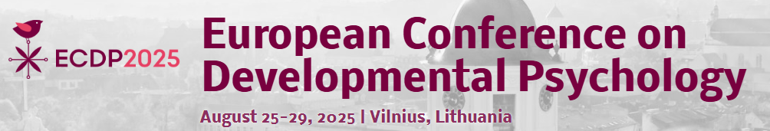

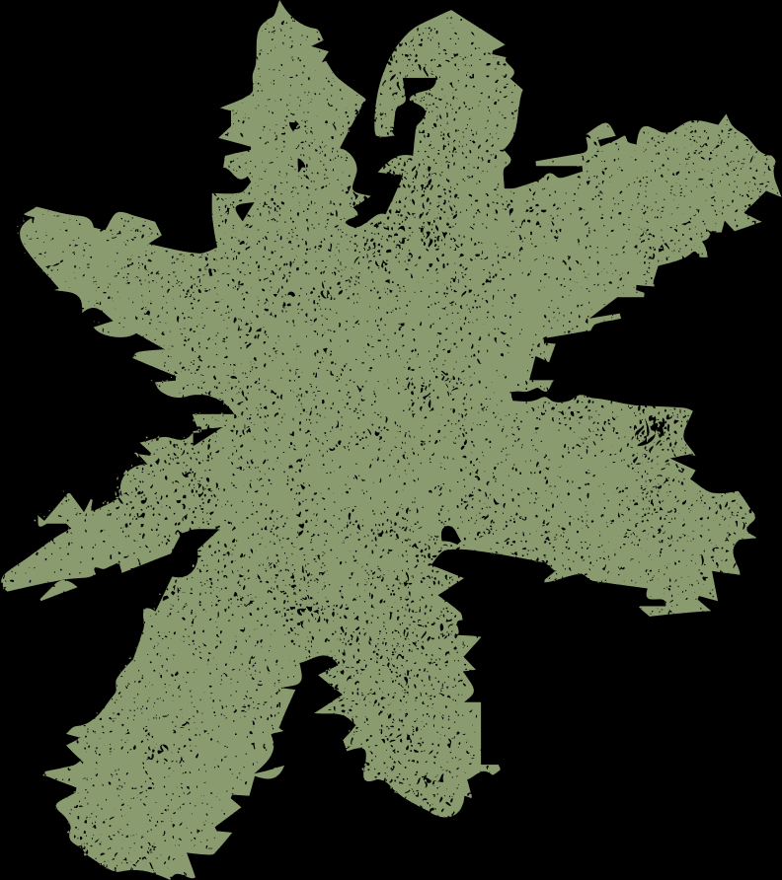




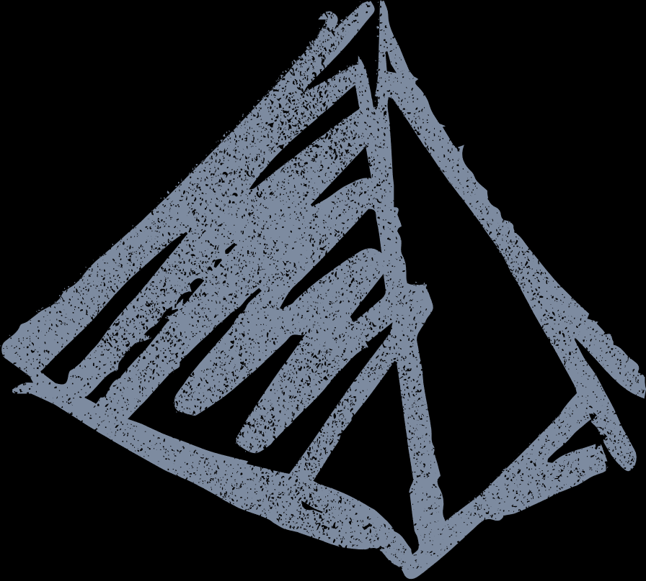

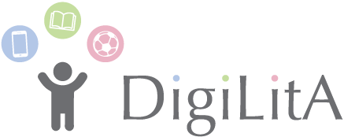
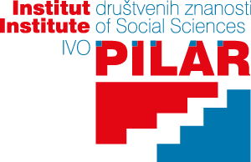



Home literacy environment and digital technology use as mediators between parental attitudes towards the importance of reading or using digital technology and vocabulary comprehension
Marina Kotrla Topić¹, Katarina Perić Pavišić¹, Ana-Marija Čango¹, Maja Kućar¹, Sinead McNally², Tihana Brkljačić¹
¹Ivo Pilar Institute of Social Sciences, Croatia;
²Dublin City University, ireland

Slide 2


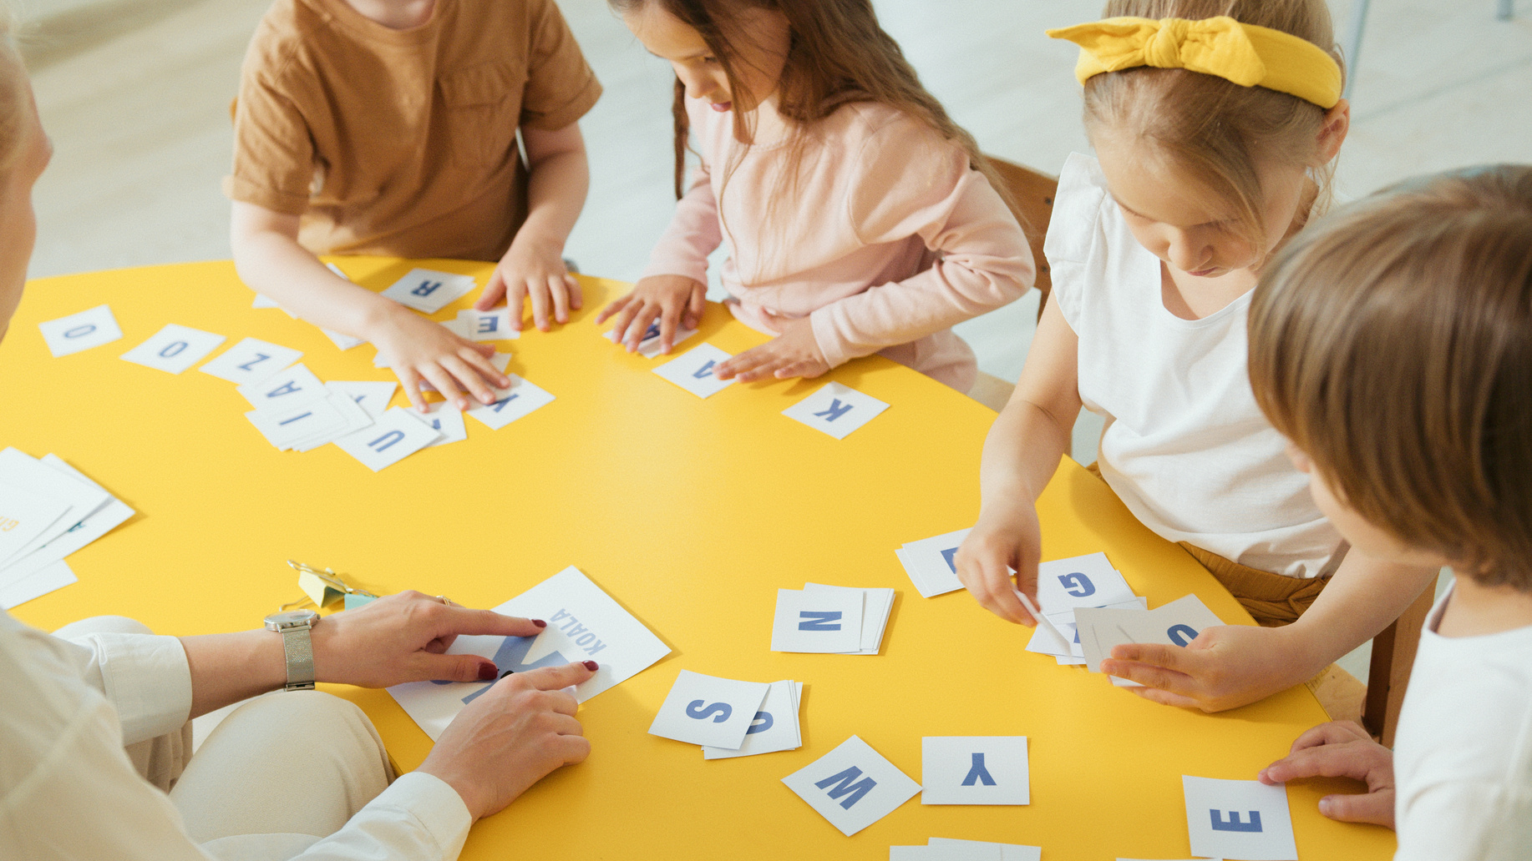


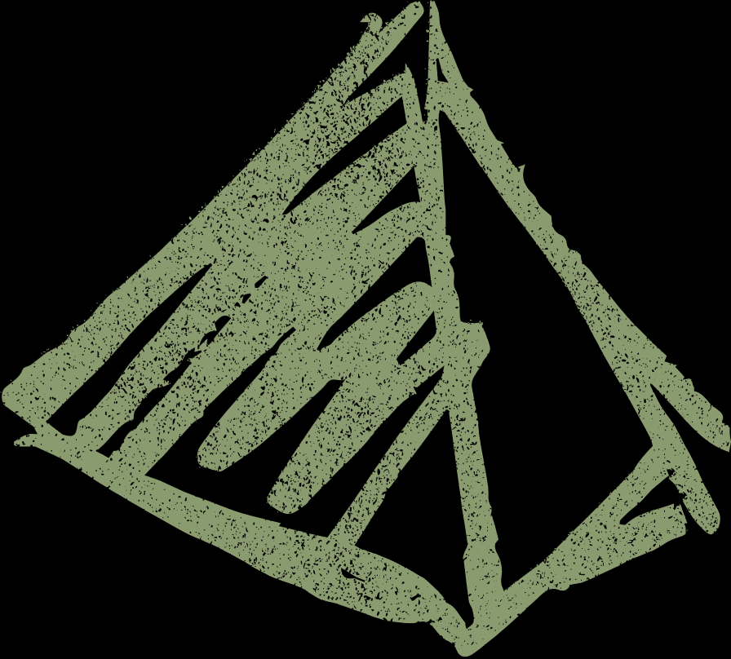

DigiLitA - The effect of environment on child development: The association of digital technology use, home literacy environment and physical activity with the well-being of children in early school years
a research project of the Ivo Pilar Institute of Social Sciences, funded by European Union programme NextGeneration EU (project number 01/02-73/23-2519-5).
www.digilita.eu

Slide 3
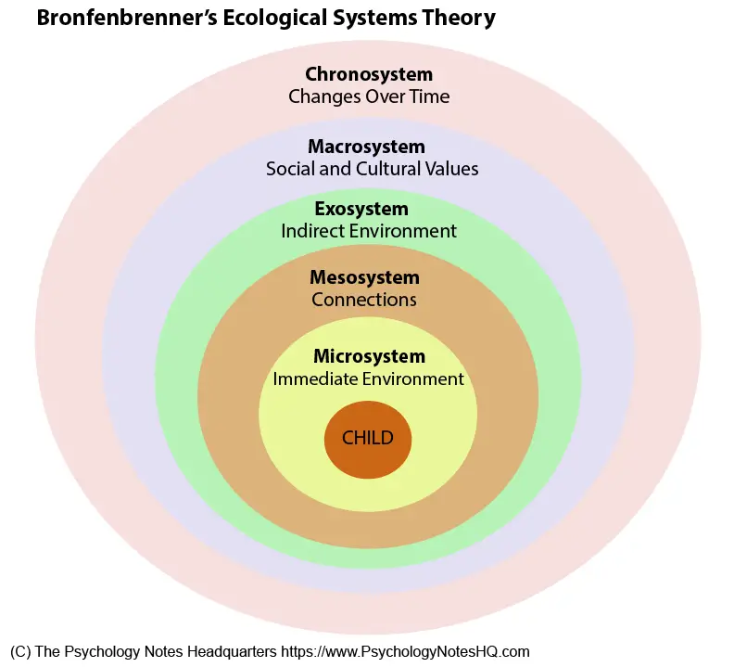
introduction
Middle childhood (6–11 years) - a transition period from childhood to adolescence
Bronfenbrenner’s ecological theory: family as key microsystem.
• Parents serve as role models to their children both in terms of their behaviour and in terms of their attitudes
Apart from having a positive attitude towards literacy activities and DT use, it is how much parents engage in these types of activities with their children that is also important for different cognitive outcomes
• Research gap: limited studies on middle childhood

Slide 4
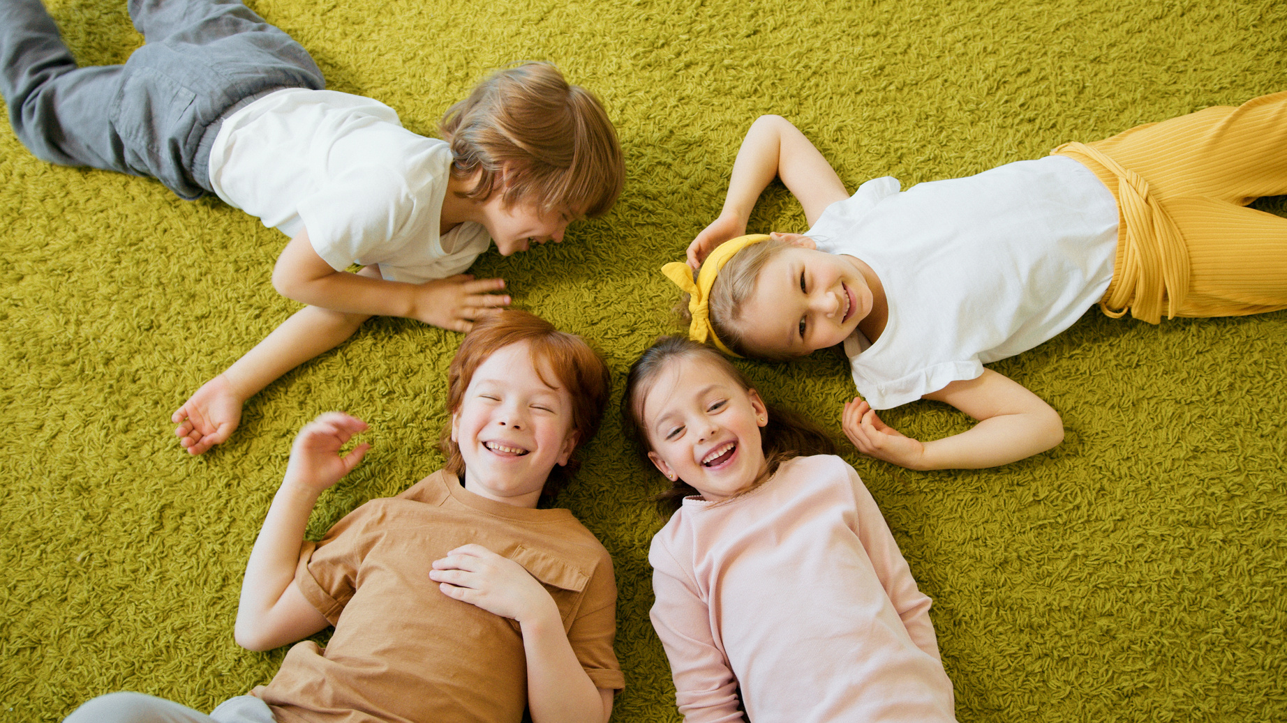
THE AIM OF THE STUDY
This study explores the relationship between
parental attitudes about the importance of reading and using digital technology and vocabulary comprehension.
The study also examines the mediating role of the home literacy environment, measured as formal and informal literacy activities that children engage in with their parents and children’s use of digital devices in the relationship mentioned above
Notes:
Starting with the assumption that children in middle childhood learn both from interactions with their caregivers and from interactions with DT, we hypothesize that positive parental attitudes about the importance of reading, as well as positive attitudes towards digital technology use, are positively related to children’s linguistic competencies. Still, we hypothesize that the relationship is mediated by the home literacy environment and children's time using DT for fun and learning, with more engagement in formal and informal literacy promoting activities as well as more DT use for fun and learning leading to better vocabulary comprehension.

Slide 5
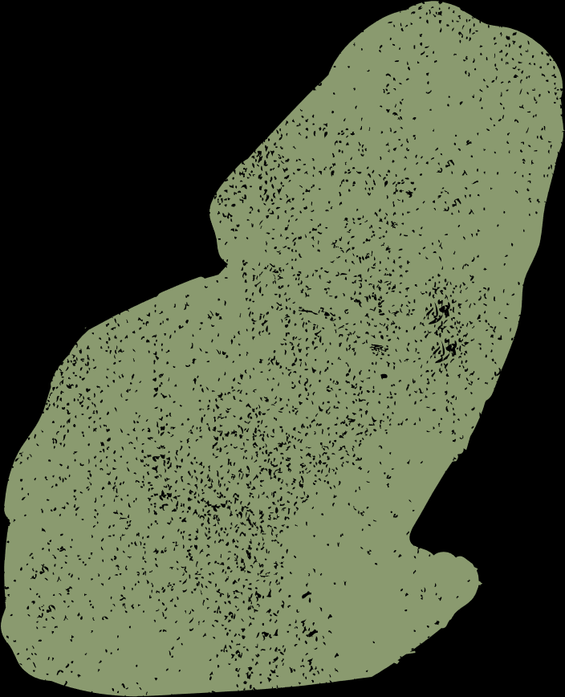




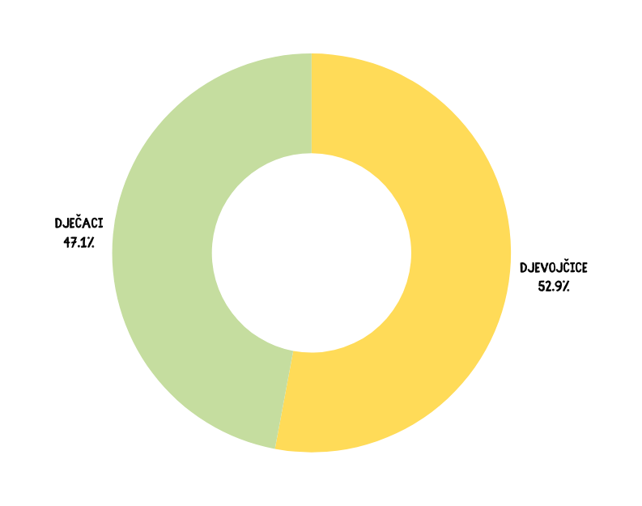
220 children and one of their parents (83.9% mothers). The children were aged from 6 to 8 years (M=7.06, SD=.331). A total of 117, 52.9% were girls.
Sample
September and October 2024.
Zoo tickets as a gift for participation
Data from the First wave
BOYS
47,1%%
GIRLS
52,9%

Slide 6



Formal and informal literacy environment
(3 items each, rated from 1-never to 5-very often)
Parental AttiTudes towards the importance of reading and using digital technology
(10 items, rated from 1-completely disagree to 5-completely agree)
MEASURES
Parental Estimates of the time children spend using digital technology for fun and learning
(2 items, rated from 1-never to 5-very often)
Children’s vocabulary comprehension
Peabody Picture Vocabulary Test (Dunn et al., 2009)

Slide 7
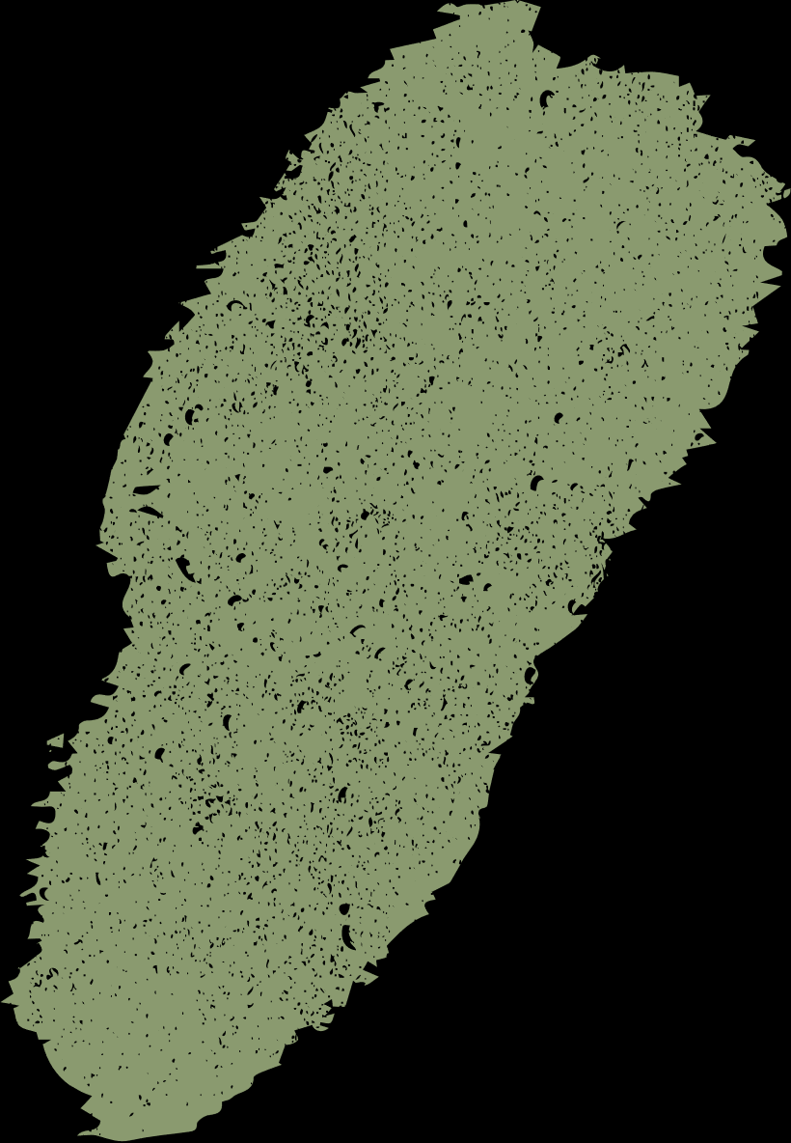


Correlations for the study variables
 | Children’s language comprehension | Parental attitudes toward the importance of reading | Parental attitudes towards the importance of using digital technology | Formal literacy environment | Informal literacy environment | DT use for fun and learning
Children’s language comprehension | 1 | .188** | -.102 | -.205** | .124† | -.231***
Parental attitudes toward the importance of reading |  | 1 | -.338*** | .009 | .269*** | -.176**
Parental attitudes towards the importance of using digital technology |  |  | 1 | -.064 | -.073 | .229***
Formal literacy environment |  |  |  | 1 | .260*** | .283***
Informal literacy environment |  |  |  |  | 1 | -.008
Children’s DT use for fun and learning |  |  |  |  |  | 1
^{†p<.10, **p<.01, ***p<.001}

Slide 8


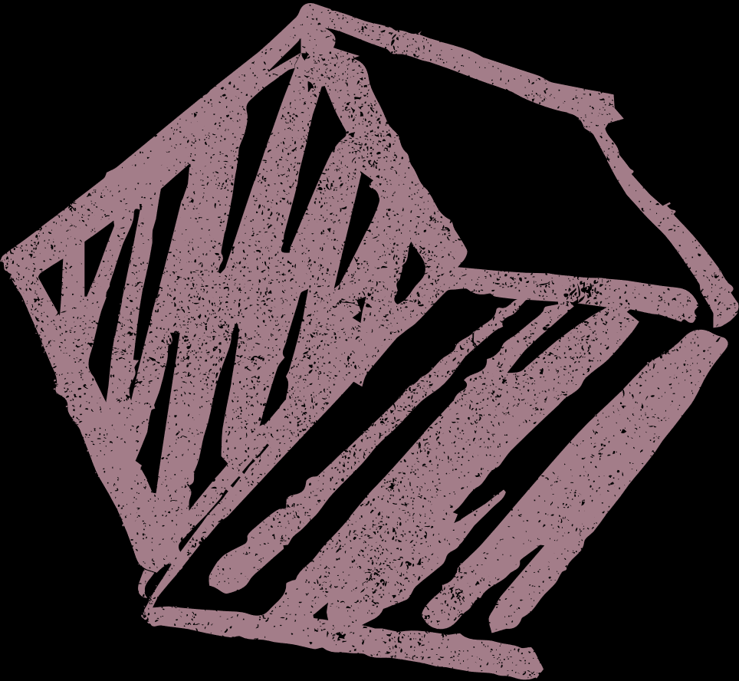

The mediation effect
To examine the mediation effect, a path analysis was conducted by using R version 4.4.0 and lavaan (Rosseel, 2012) and Hmisc (Harrell, 2025) package. The proportion of missing data was low (i.e., 11 participants had incomplete data across variables); therefore, full information maximum likelihood (FIML) estimation was used.
The mediation model tested the indirect effects of parental attitudes toward reading and digital technology use on language comprehension through both formal and informal literacy environments, as well as digital technology activities. The bootstrapping method with 10000 iterations was employed to estimate bias-corrected confidence intervals for the indirect effects. Model parameters were estimated using the maximum likelihood (ML) algorithm.

Slide 9
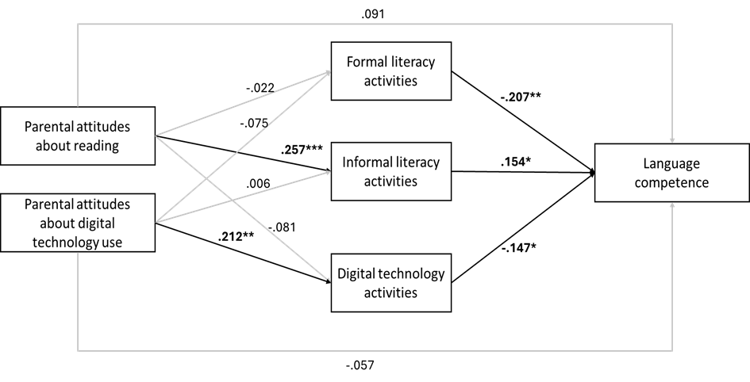
The effects of parental attitudes towards reading and digital technologies on children’s language competence

Slide 10
Indirect effects of parental attitudes toward reading and digital technologies on language competence with bootstrapped confidence intervals
Path | Indirect effect | CI lower | CI upper
Attitudes toward reading → informal literacy activities → LC | 0.864 | 0.134 | 2.069
Attitudes toward reading → formal literacy activities → LC | 0.101 | -0.528 | 0.775
Attitudes toward reading → DT use → LC | 0.26 | -0.093 | 1.034
Attitudes toward DT → informal literacy activities → LC | 0.024 | -0.687 | 0.758
Attitudes toward DT → formal literacy activities → LC | 0.392 | -0.29 | 1.377
Attitudes toward DT → DT use → LC | -0.785 | -1.994 | -0.133

Slide 11
Discussion AND conclusion
The main contribution of this study is that having positive attitudes towards the importance of reading for children in middle childhood is related to children’s language skills through actual participation in activities that promote an informal literacy environment at home.
Formal literacy activities may reflect compensatory efforts for children with weaker skills
Furthermore, attitudes towards the importance of digital technology (DT) use were negatively related to children’s language abilities at this specific age through more use of DT for fun and educational purposes.

Slide 12


ačiū už jūsų dėmesį
www.digilita.eu
digilita@pilar.hr

