Slide 1




















Physical activity and not digital technology use predict primitive reflexes in first-grade pupils in Croatia
Marina Kotrla Topić¹, Ana-Marija Čango¹, Marija Heffer
¹Ivo Pilar Institute of Social Sciences, Croatia;
²faculty of medicine in Osijek, Croatia

Slide 2


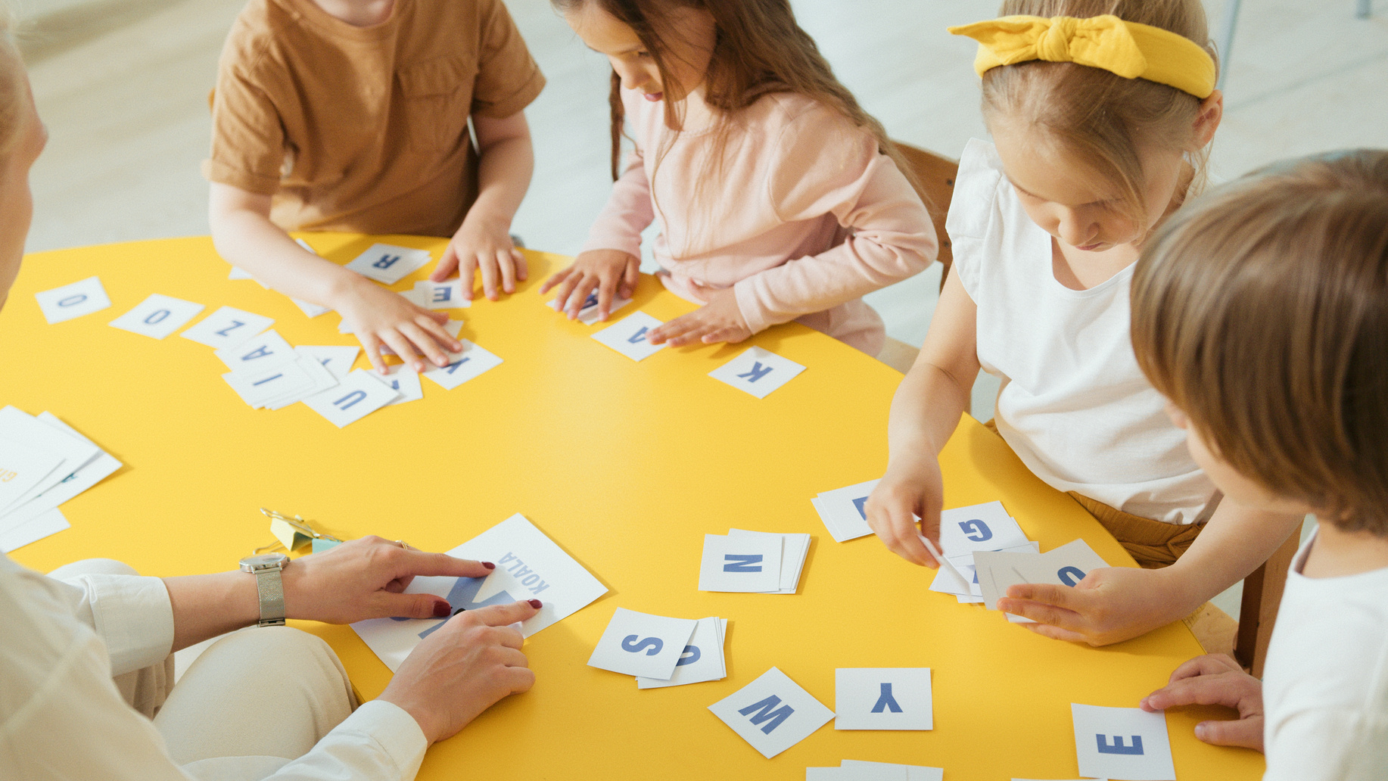




DigiLitA - The effect of environment on child development: The association of digital technology use, home literacy environment and physical activity with the well-being of children in early school years
a research project of the Ivo Pilar Institute of Social Sciences, funded by European Union programme NextGeneration EU (project number 01/02-73/23-2519-5).
www.digilita.eu

Slide 3
Introduction
Primitive reflexes
consequences of persistance
• Difficulties with coordination, balance, and fine motor skills
• Connected to challenges in focus, attention, and visual perception
• Related to ADHD and academic struggles
• May hinder reading, writing, and organizing tasks
• Automatic, involuntary movements present at birth or early motor development
• Typically disappear as the nervous system matures (6–12 months, up to 3.5 years for TLR)
• Help infants respond to visual, auditory, and proprioceptive stimuli

Slide 4
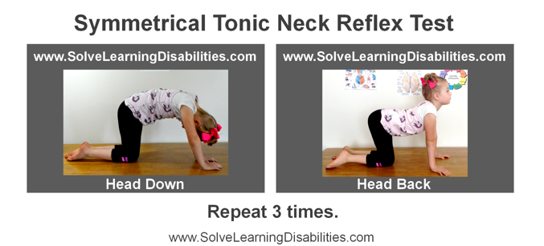
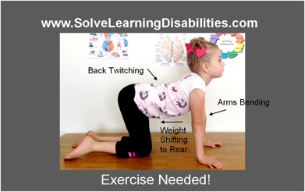
Key reflexes in middle childhood
• Asymmetrical Tonic Neck Reflex (ATNR)
– Present at birth, inhibited by 6 months
– Important for crawling, hand-eye coordination, reading
• Symmetrical Tonic Neck Reflex (STNR)
– Appears 5–8 months, supports crawling/creeping
– Persistence affects posture, coordination, school tasks
• Tonic Labyrinthine Reflex (TLR)
– Present at birth, controls head-body position
– Persistence impacts balance, posture, eye control

Slide 5

Causes of retention
• Neurological disease, trauma, chronic infections, toxins
• Skipped crawling/creeping or delayed motor milestones
• Lack of physical activity in early childhood
Digital technology & time displacement
Excessive screen time linked to less physical activity
• WHO guidelines: ≥180 min/day of physical activity, ≤1 h sedentary screen time
• Few children meet both guidelines globally
• Time Displacement Theory: technology use reduces time for physical and social activities

Slide 6

THE AIM OF THE STUDY
• Investigate the retention of ATNR, STNR, and TLR in children aged 6–8
• Examine whether reflex persistence can be predicted by:
– Time spent in different physical activities
– Time spent using digital technology

Slide 7




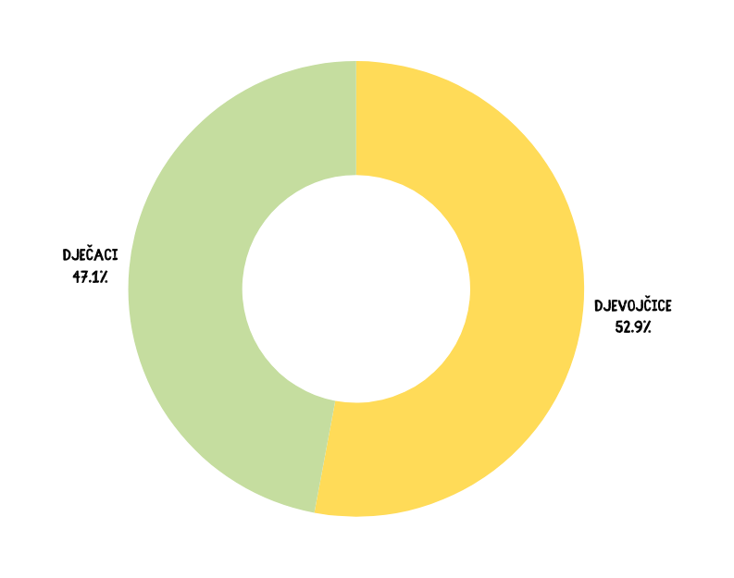
220 children and one of their parents (83.9% mothers). The children were aged from 6 to 8 years (M=7.06, SD=.331). A total of 117, 52.9% were girls.
Sample
September and October 2024.
Zoo tickets as a gift for participation
  Data from the First wave
BOYS
47,1%%
GIRLS
52,9%

Slide 8

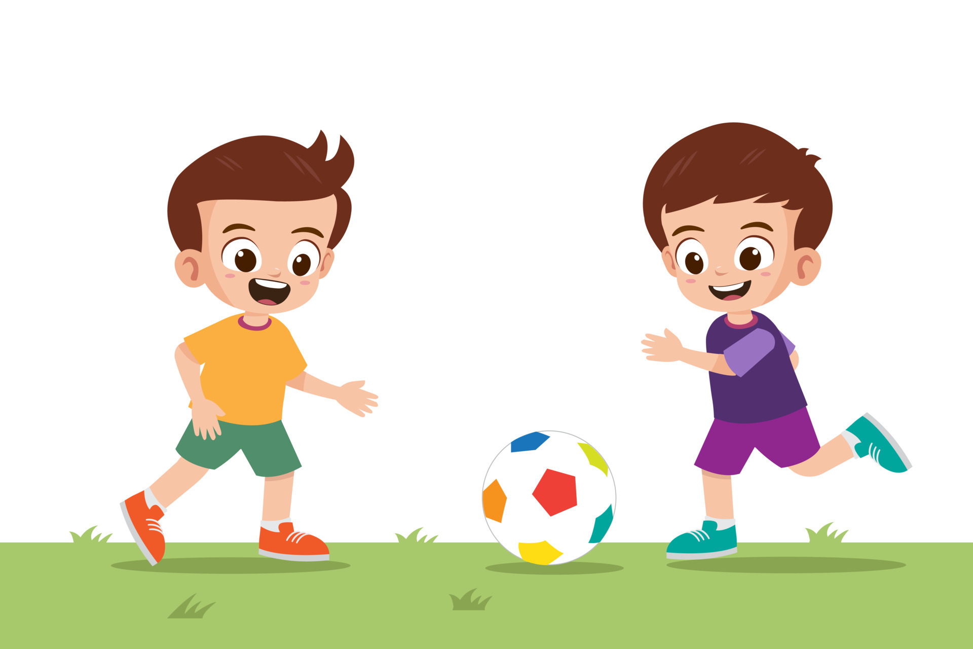
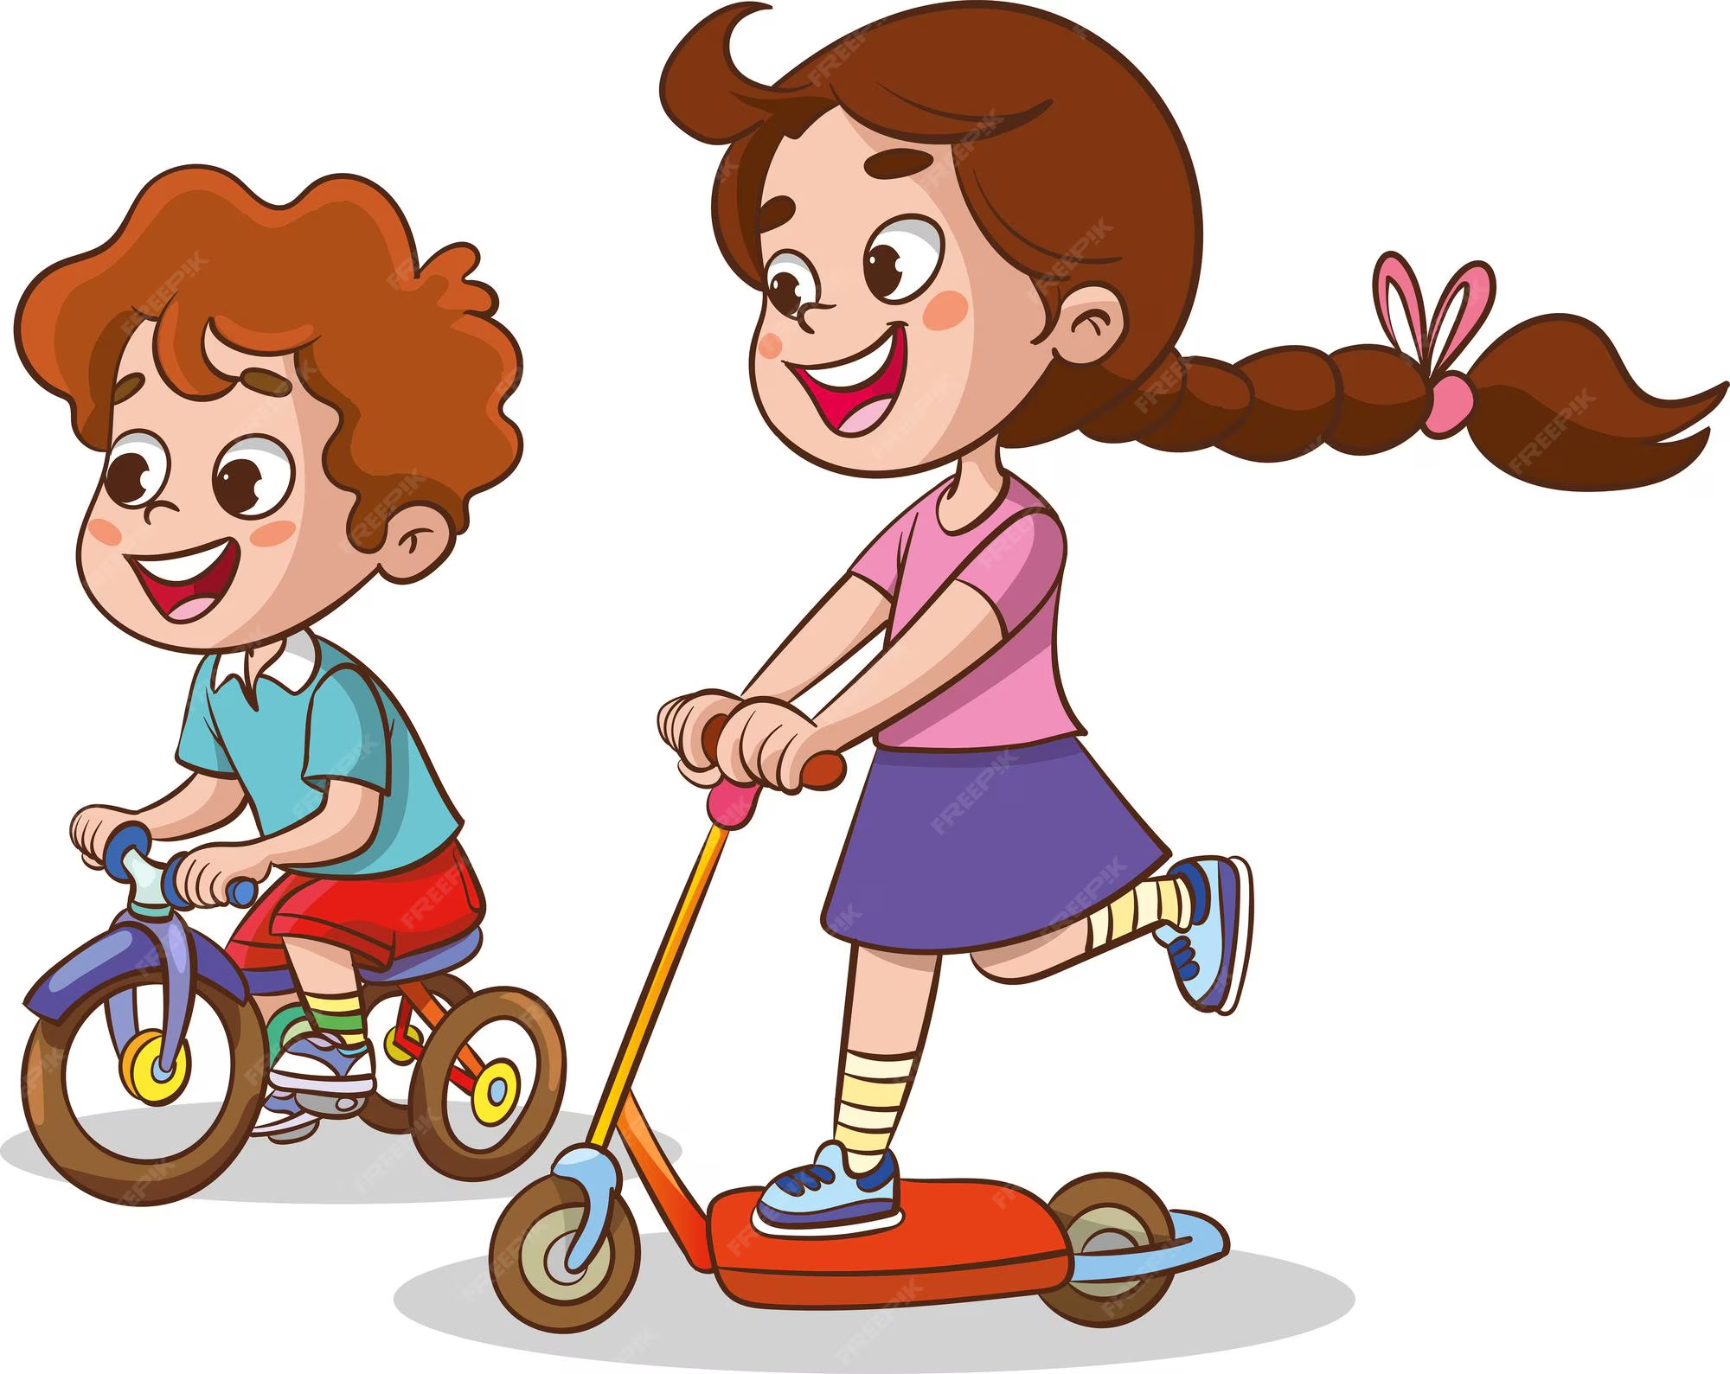

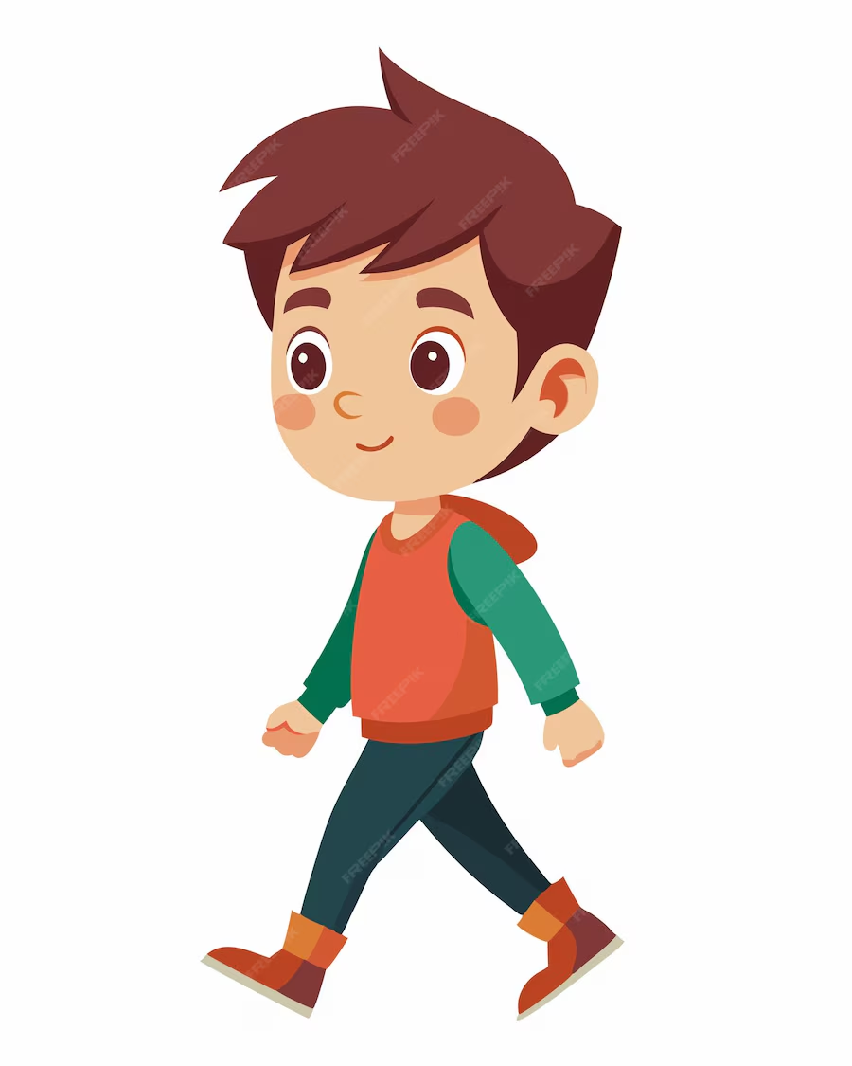
Parental Estimates of how often, during a typical week, their child:
plays with other children outside (on the street, a playground, or a sports field),
goes for a walk, or
rides a bicycle, scooter, or skates.
The answers were given on a scale from 0 (“Never) to 7 (7 times a week).
Parental Estimates of the time children spend using digital technology for fun and learning
(rated from 1-never to 5-very often)
MEASURES
Children’s primitive reflexes
The INPP Developmental Screening Test and School Intervention Programme (Goodard Blythe, 2012)

Slide 9



Descriptive statistics for the study variables
 | N | M | Sd | Min-max | Skew | Kurtosis
Physical activity-playing | 218 | 4.30 | 1.93 | 0-7 | -0.12 | -1.01
Physical activity-walking | 217 | 3.82 | 2.01 | 0-7 | 0.09 | -1.02
Physical activity-bike/scooter/skates | 216 | 3.93 | 1.97 | 0-7 | 0.05 | -0.93
DT-games for fun | 219 | 3.09 | 0.97 | 1-5 | -0.22 | -0.22
Primitive reflexes | 215 | 1.79 | 2.04 | 0-11 | 1.16 | 1.17
Age | 221 | 7.06 | 0.33 | 6.33-8 | 0.31 | -0.39
40.5% of children had no primitive reflexes retention

Slide 10
Correlations for the study variables
 | Physical activity-playing outside | Physical activity-walking | Physical activity-bike/scooter/skates | DT-games for fun | Primitive reflexes | Age | Gender
Physical activity-playing outside | 1 | .538** | .534** | -.146* | -.055 | .024 | -.008
Physical activity-walking |  | 1 | .508*** | -.148* | -.161* | .163* | .134*
Physical activity-bike/scooter/skates |  |  | 1 | .011 | -.223** | .011 | -.007
DT-games for fun |  |  |  | 1 | .003 | -.048 | -.181**
Primitive reflexes |  |  |  |  | 1 | -.011 | -.177**
Age |  |  |  |  |  | 1 | -.146*
Gender∞ |  |  |  |  |  |  | 1
*p<.05, ** p<.01, ***p<.001, ∞gender was coded as 0 for boys and 1 for girls

Slide 11
Hierarchical Regression Results
 |  |  |  |  | 95%CI
Predictor | B | β | t | p | Low | Up | Adj. R² | ΔAdj.R² | P
Step 1 |  |  |  |  |  |  | .019 | .019 | .053
Age | -.324 | -.055 | -.796 | .427 | -1.128 | .479
Gender | -.644 | -.165 | -2.389 | .018 | -1.176 | -0.113
Step 2 |  |  |  |  |  |  | .062 | .043 | .004
Age | -.250 | -.042 | -.612 | .541 | -1.055 | .555
Gender∞ | -.594 | -.152 | -2.158 | .032 | -1.136 | -.051
PA-playing | .139 | .138 | 1.585 | .114 | - .034 | .312
PA-walking | -.043 | -.045 | -.515 | .607 | -.209 | .122
PA-bike, skates | -.271 | -.274 | -3.263 | .001 | -.434 | -.107
DT-games for fun | .039 | .020 | .282 | .778 | -.235 | .313
*p<.05, ** p<.01, ***p<.001, ∞gender was coded as 0 for boys and 1 for girls

Slide 12




Discussion AND conclusion
Provides preliminary evidence that gender and engagement in activities requiring coordination, such as riding a bicycle or skates, are associated with the integration of primitive reflexes in first-grade children
In Croatia, as in many other European countries, primitive reflexes are not included in standard developmental assessments
Findings have practical implications for educators and parents

Slide 13


Hvala na pažnji
www.digilita.eu
digilita@pilar.hr

